Slide 1

TalentCraft: AI-Powered Resume & Job Matching Platform + Career Campanion
A Project Presentation by
Monpara Romil Kamleshbhai
Enrollment No.: 23002170210064

Slide 2

Project Vision & Mission
1
2
Vision
Mission
To empower job seekers with intelligent tools to navigate their career path confidently.
To provide a comprehensive platform for resume building, interview practice, job matching, and profile management through a seamless, user-centric experience.
TalentCraft leverages Django REST Framework for a robust backend and React for a dynamic frontend, creating a powerful and intuitive career development ecosystem.

Slide 3
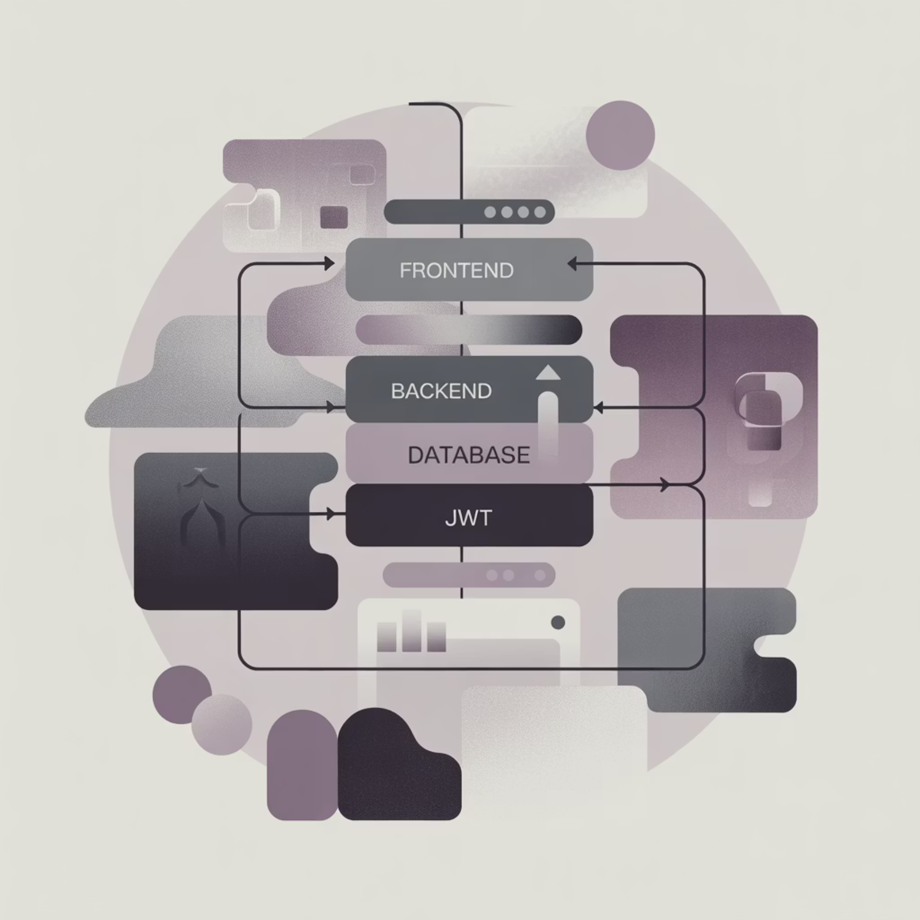
High-Level Architecture: A Modern Full-Stack Approach
Backend: A powerful and modular API built with Django and Django REST Framework.
Frontend: A dynamic Single-Page Application (SPA) built with React and Vite for speed.
Communication: Secure, token-based (JWT) authentication for seamless interaction.
Database: PostgreSQL for robust, scalable data management.

Slide 4
The Backend Engine: Django REST Framework
Users App
Chatbot App
Jobs App
Authentication (JWT), profile management, and resume parsing.
Powers the interactive HR interview coach with dynamic responses.
Manages job creation and listing, forming the core of job discovery.
Job Match App
Resumes App
Special Training for Trainee
The core algorithm for scoring user profiles against job descriptions.
On-the-fly PDF resume generation using ReportLab.
Close skill gaps with guided modules

Slide 5
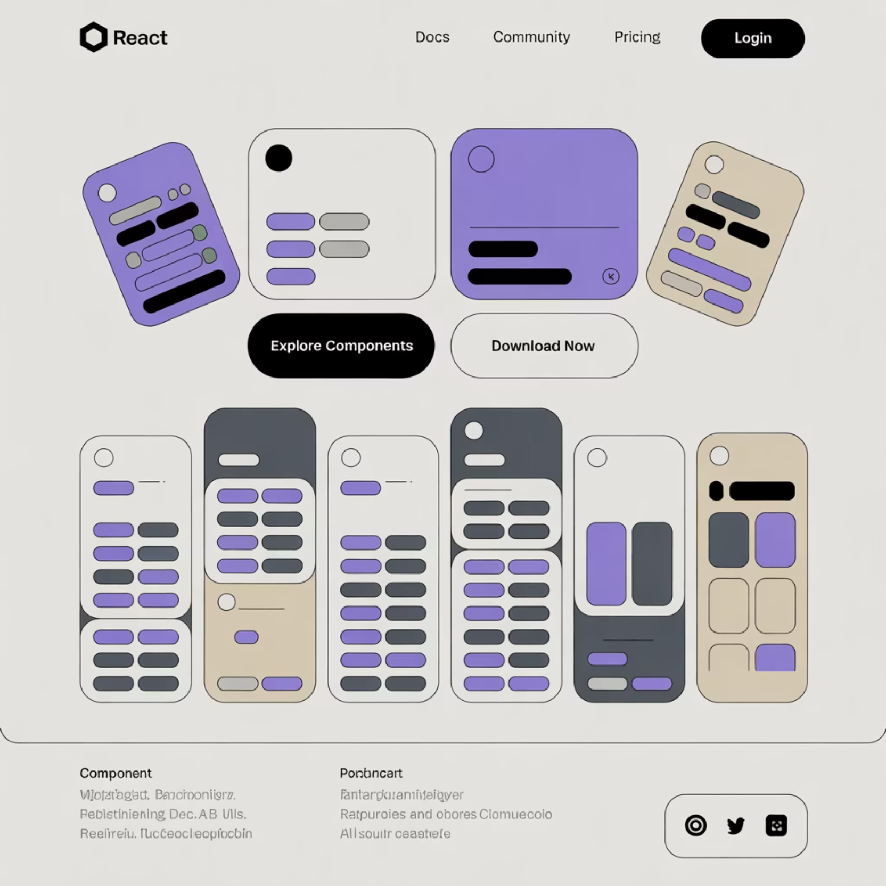
The Frontend Experience: React & Vite
Built with React and Vite, our frontend delivers a fast, modern, and highly responsive user experience.
Routing: react-router-dom manages seamless client-side navigation.
Component-Based
API Communication: axios handles all secure interactions with the Django backend.
Styling: Modern and responsive UI crafted with Tailwind CSS.

Slide 6

Key Feature 1: Automated Resume Parser
User uploads a PDF resume via the React UI.
File is securely sent to the Django backend.
PyMuPDF (fitz) extracts raw text from the PDF.
Regular Expressions parse text to identify and extract key sections (experience, skills, education).
Extracted data is saved to the user's profile in the database.

Slide 7
Key Feature 2: AI Job Matcher
The AI Job Matcher provides users with an instant, actionable score on how well their profile fits a job description:
Algorithm Core
Actionable Feedback
Extracts required skills from job descriptions and performs a multi-faceted analysis of the user's active profile, including:
The API returns more than just a score; it provides:
Reasons: Clear explanations for the match score.
Suggestions: Actionable advice for profile improvement, enhancing future matches.
Skill-to-Skill Comparison: Calculates a core skill match percentage.
Keyword Analysis: Checks summary and experience for keyword alignment.

Slide 8

Key Feature 3: Interactive Interview Coach
Our interactive interview coach provides a realistic practice environment through a real-time, modal-based chat interface.
Speech-to-Text: Users can practice speaking answers using the browser's Speech Recognition API.
Typing Simulation: Bot messages appear character-by-character for a more natural conversational flow.
Instant Feedback: The backend provides simple, keyword-based feedback on user answers.
Session Management: Users can manually stop the interview and receive a summary of their practice session.

Slide 9

Key Feature 4: Dynamic PDF Resume Builder
Generates a professional, formatted PDF resume on demand, directly from the user's structured profile data.
Technology: Uses the ReportLab library on the backend to "draw" the PDF.
Dynamic Content: Resume content is built entirely from the user's database profile, ensuring accuracy and currency.
Automatic Layout: Intelligently handles text wrapping and creates new pages for content overflow, ensuring readability.
Professional Styling: Applies modern fonts, colors, and structured layouts for a clean, impactful document.

Slide 10
Conclusion & Next Steps
TalentCraft is a robust, full-stack application that provides tangible value to job seekers through its suite of intelligent, automated tools.
Future Enhancements
Implement a background task queue (e.g., Celery) for faster resume processing.
Enhance the Job Matcher with more advanced NLP techniques for deeper insights.
Introduce multiple resume templates for the PDF generator, offering more customization.
Develop a dashboard for users to track application history and progress.
Thank you!

